Slide 1
Data Protection and GDPR

Slide 2
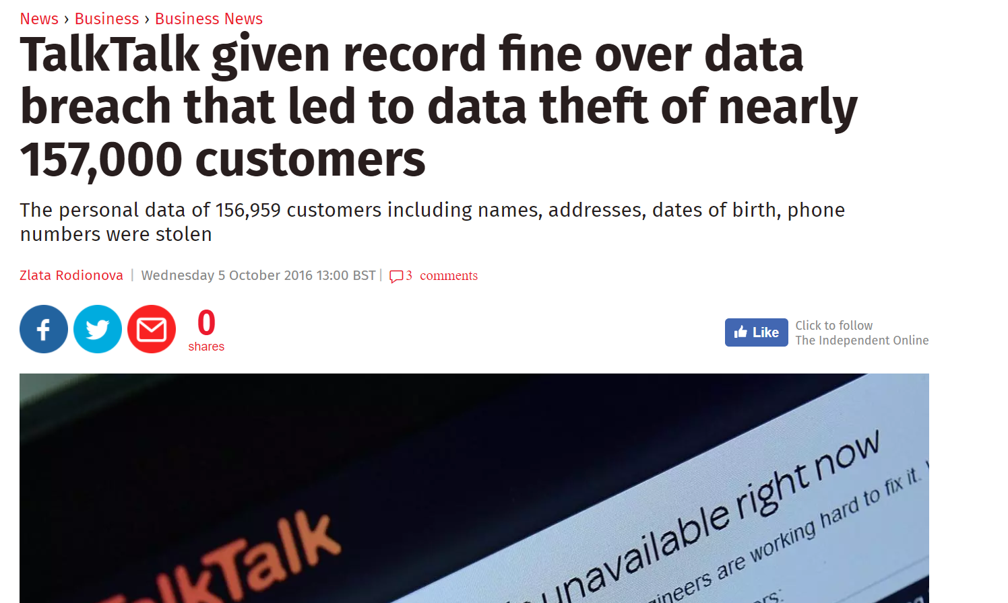
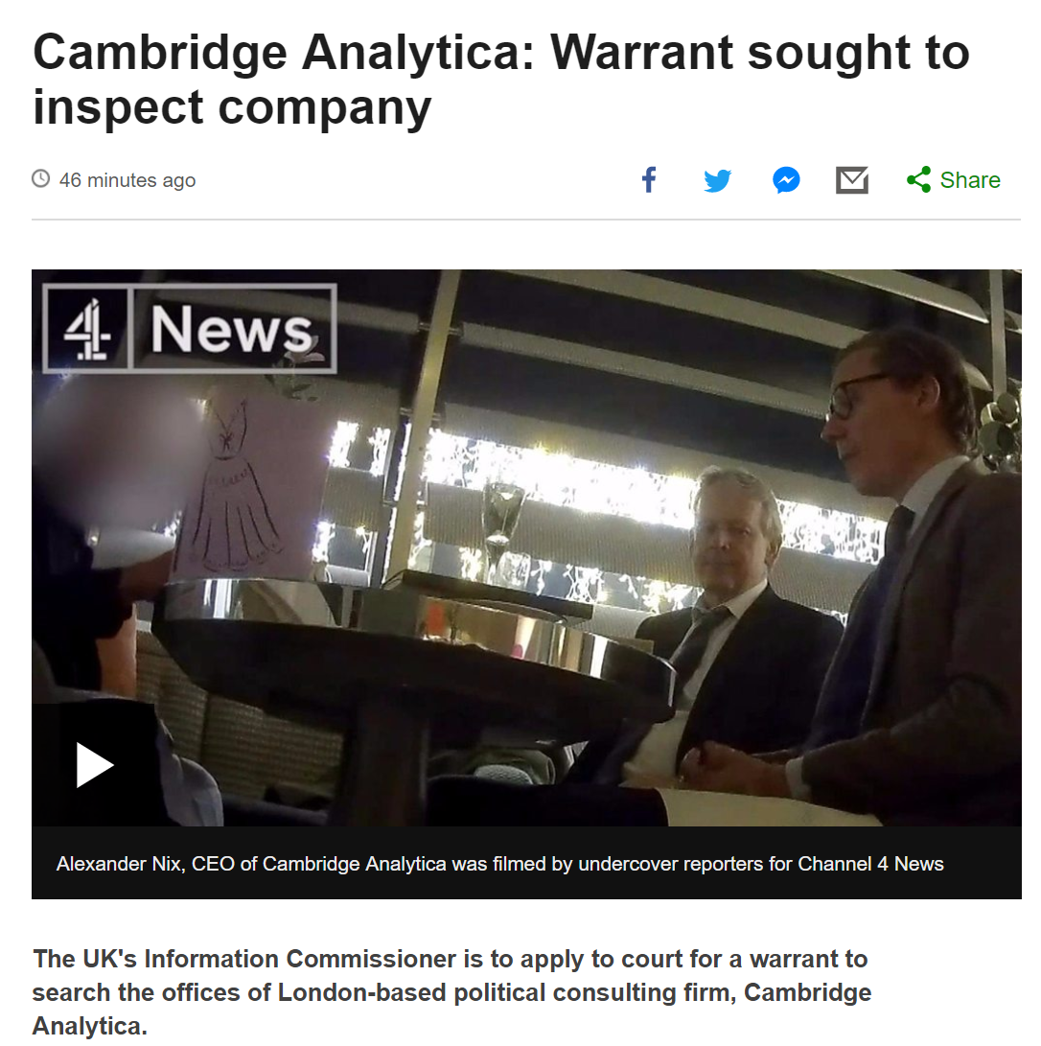
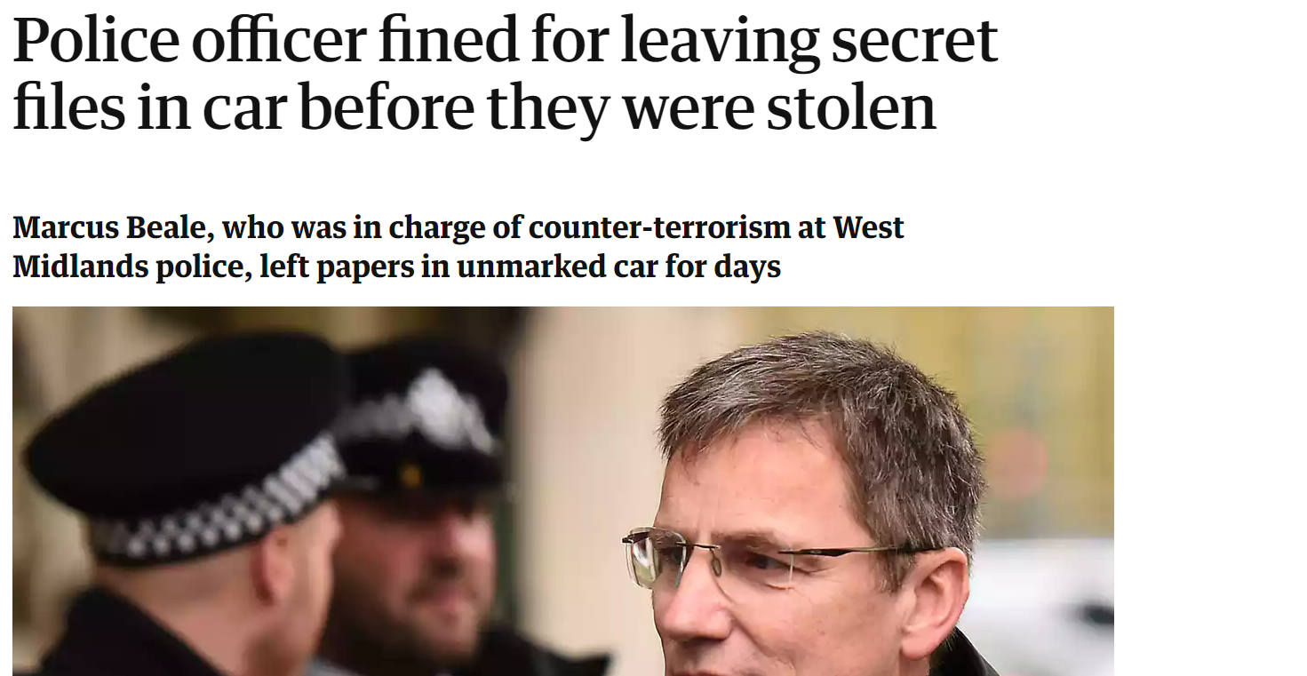
Why do we care?
Notes:
Highlighting abuses of data.
First Story - Facebook, Cambridge Analytica - ask who has FB account. then who had read FB ts and Cs
Second - Talk Talk - 400K fine, largest issues by ICO - ask if there are TT customers
Third - story of lost terrorism paper...an example of “it will never happen to me”
Point out rising awareness of GDPR...Cliff Richard, suing under DPA

Slide 3

Notes:
Comes into force on May 25th
Is a law and all schools must be compliant
Additional accountability
A higher profile for data protection
Enhanced rights for data subjects
Higher expectations from everyone

Slide 4
Terminology
Personal Data | Data Subject | Controller | Processor
Data Breach | Data Protection Bill | ICO | Subject Access Request
Privacy Notice | Data Minimisation | Data Retention | Right to be Informed
Right of Rectification | Right of Erasure or to be Forgotten | Data Protection Officer | Lawful Basis for Processing
Consent | Encryption | Data Mapping | Accountability under GDPR
Notes:
Ask who knows any
Talk through Personal Data, Data Subject
Point out most of these aren’t new, expect for accountability and Right of Erasure...tell the story of Snr Gonzales the most famous bankrupt in the world:
https://www.wikiwand.com/en/Google_Spain_v_AEPD_and_Mario_Costeja_Gonz%C3%A1lez

Slide 5
Preparing for Compliance
What is the GDPR
What isn’t the GDPR
Protection for individuals
Modern
EU wide
A law
More accountability for organisations
All about fines
Only relevant until Brexit
Something to ignore

Slide 6
Data subjects…
It’s YOUR data
Organisations…
You are the custodians

Slide 7
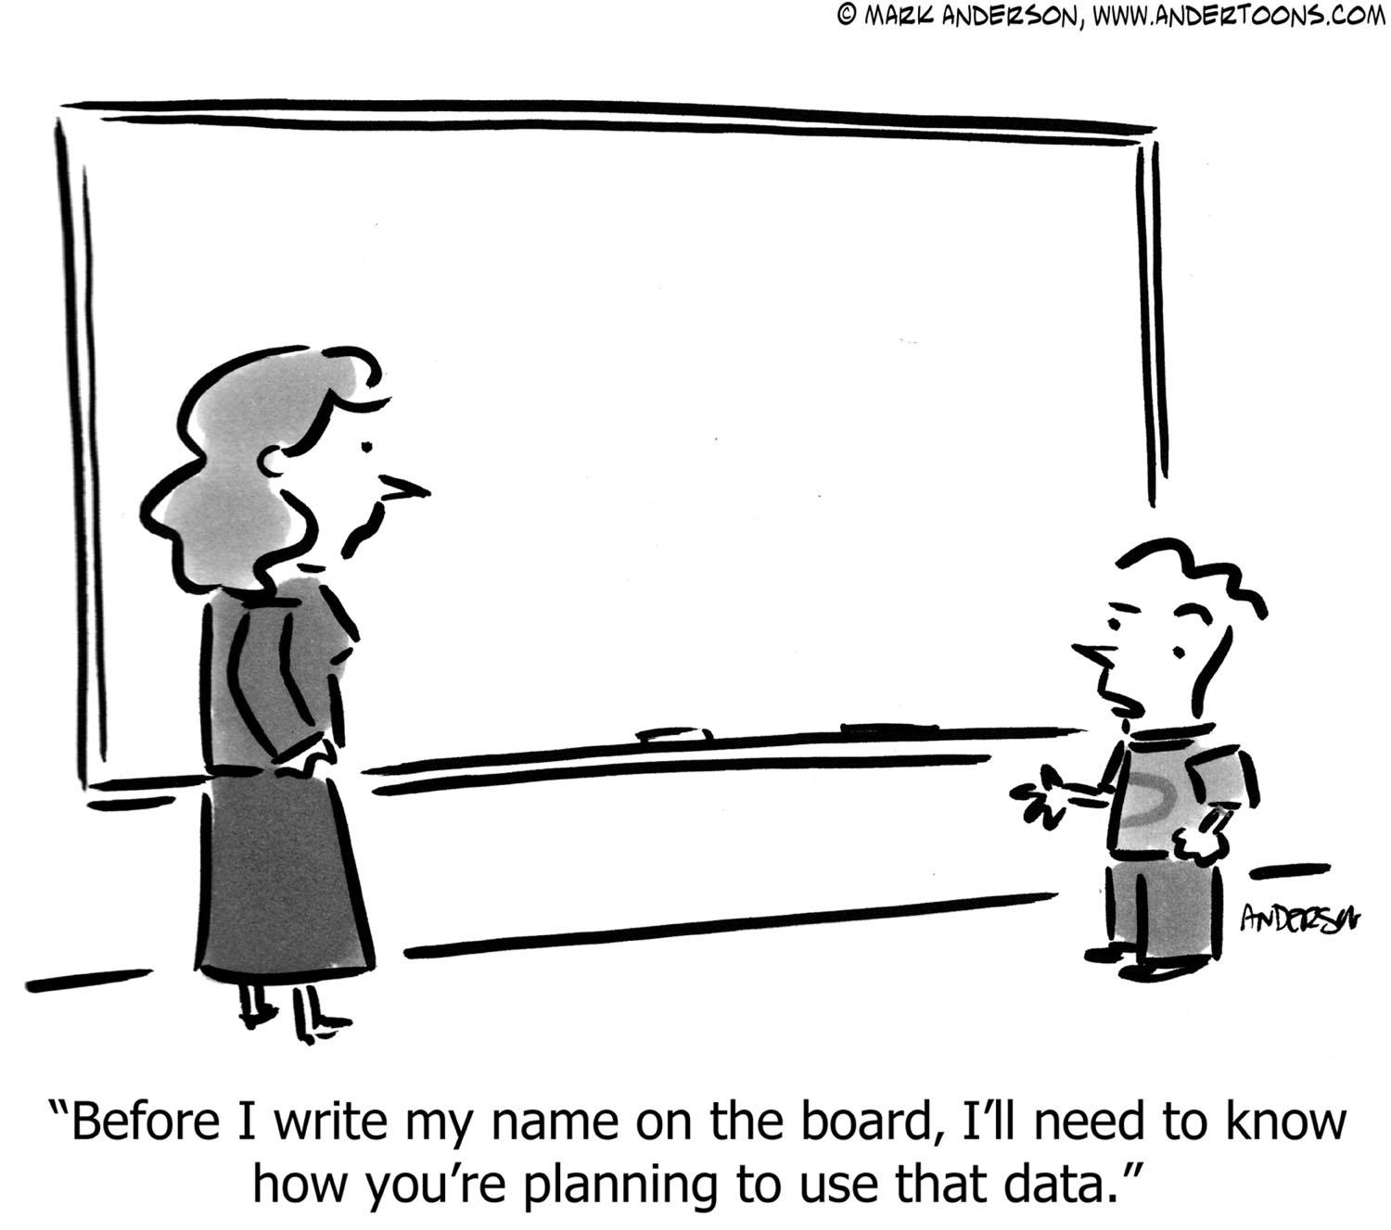
Notes:
Data Subject = natural living person...be careful what you teach in British Values :)

Slide 8

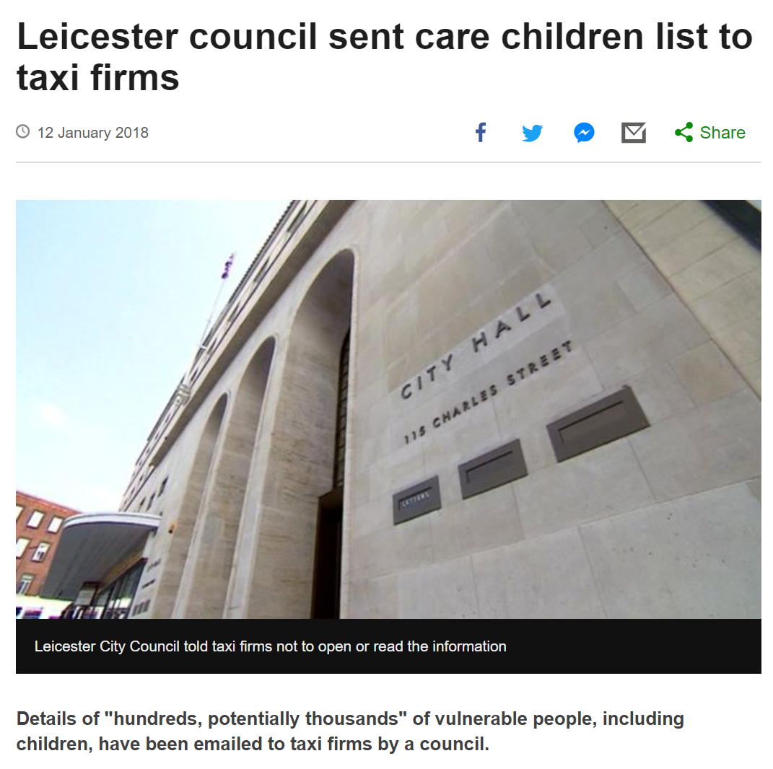
Breach Alert!
Notes:
Tell the story:
http://www.bbc.co.uk/news/uk-england-leicestershire-42667451

Slide 9
Preparing for Compliance
What is the GDPR
What isn’t the GDPR
There is an increase in the profile of data protection
Protection for individuals
Modern
EU wide
A law
More accountability for organisations
All about fines
Only relevant until Brexit
Something to ignore
Notes:
There’s an increase in awareness...reflect on how that might materialise with greater awareness in parents and pupils

Slide 10

Preparing for Compliance
Personal data must be
Processed lawfully
For a specific purpose
Kept to a minimum
Accurate and up-to-date
Retained only for as long as it is needed
Kept securely
The
Six Data Principles
Notes:
GDPR is principle based...it makes it aspirational....we have to demonstrate a commitment to GDPR

Slide 11
Reasons to process data
Contractual
Legal obligation
Protecting vital interests
Public interest
Consent
Legitimate interest
Lawful Basis
for Data Processing
Notes:
Known as the lawful basis
Contractual Such as employment contracts for staff.
Legal obligation Such as collecting attendance data for statutory returns.
Protecting vital interests Such as disclosing medical information to health professionals or information for references.
Public interest This applies to data collected for statutory purposes. (ICO for schools “most, if not all of your data...”)
Consent Information Society Services: For children under the age of 13, this consent must be given by their parents. Consent may also be withdrawn. Ask where consent is used...no need for consent where a legal obligation exists (eg. medical - Children and families Act 2014)
Legitimate interest Such as for marketing purposes. If you do use email marketing, consent is the most appropriate basis for processing this data. Not really to be used by public authorities

Slide 12

Do we need consent?
Do you need consent for every piece of personal data you hold?
What is the age of consent?
Notes:
In schools generally only for the use of photographs on promotional activities such as the website and when sharing news with local papers and social media
Consent must be explicit, freely given, unambiguous...and as easy to withdraw as it is to give

Slide 13
Preparing for Compliance
Right to be informed
Right of access
Right of rectification
Right of erasure
Right to restrict processing
Right to object
Right to data portability
Rights in relation to automated decision making
The
Rights of Data Subjects
Survey response
20% of schools have had a subject access request
27% aren’t sure
Notes:
Right of access relates to subject access requests and the data must be shared with the data subject within one month
Schools not comfortable with rehearsing an SAR can document their experiences of them and how they would improve processes in the future
SIMS has a new report. There is a new access level called Data Protection Officer and a subject access report which downloads all of the information in SIMS on that individual - lots of data is spread across the school but this is a start
Schools say that subject access requests tend to be
From parents when their child has had an issue with another child – issues over protecting the other child’s information here
From staff when there is a grievance

Slide 14
Activities to prepare
Data mapping
Updating policies
Updating /developing procedures
Staff training
Recording processing activity
…changing behaviour

Slide 15

How do you expect others to look after your data?
Notes:
The one important take-away for staff...think about treating other people’s data, as you want yours to be treated. Think about privacy first.
I use the story of finding a Teacher Support Plan in the bin of an office. Would a teacher like that information to be thrown in a bi if it was about them? Ask what should happen to it

Slide 16
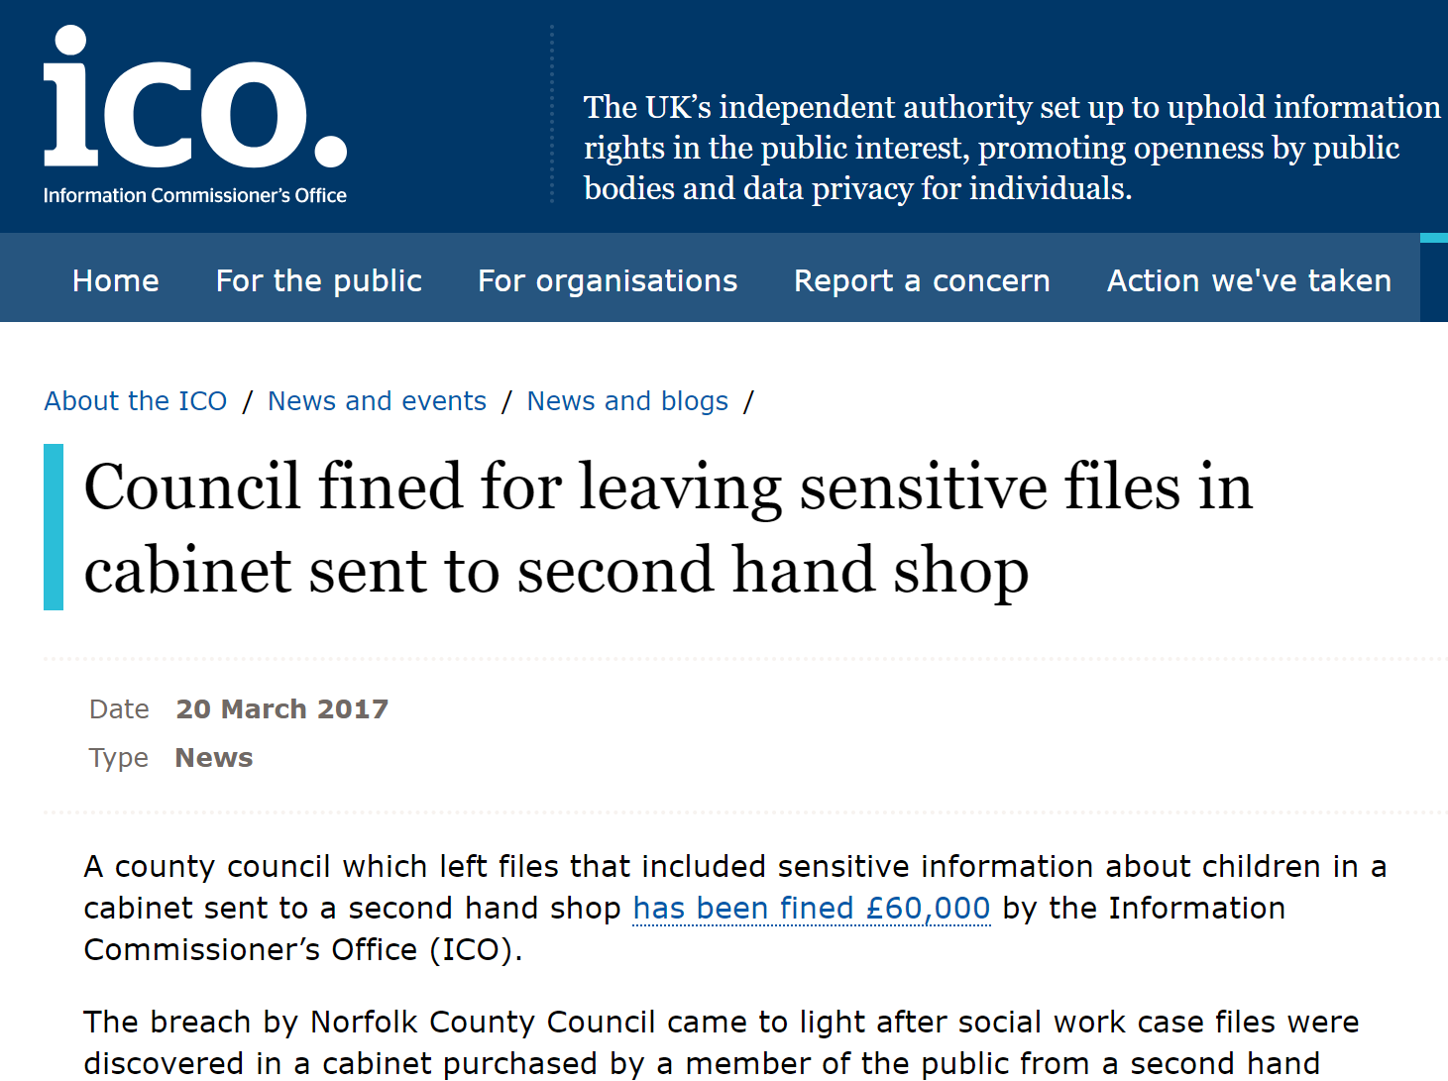
Breach Alert!
Notes:
Tell the story…
https://ico.org.uk/about-the-ico/news-and-events/news-and-blogs/2017/03/council-fined-for-leaving-sensitive-files-in-cabinet-sent-to-second-hand-shop/

Slide 17
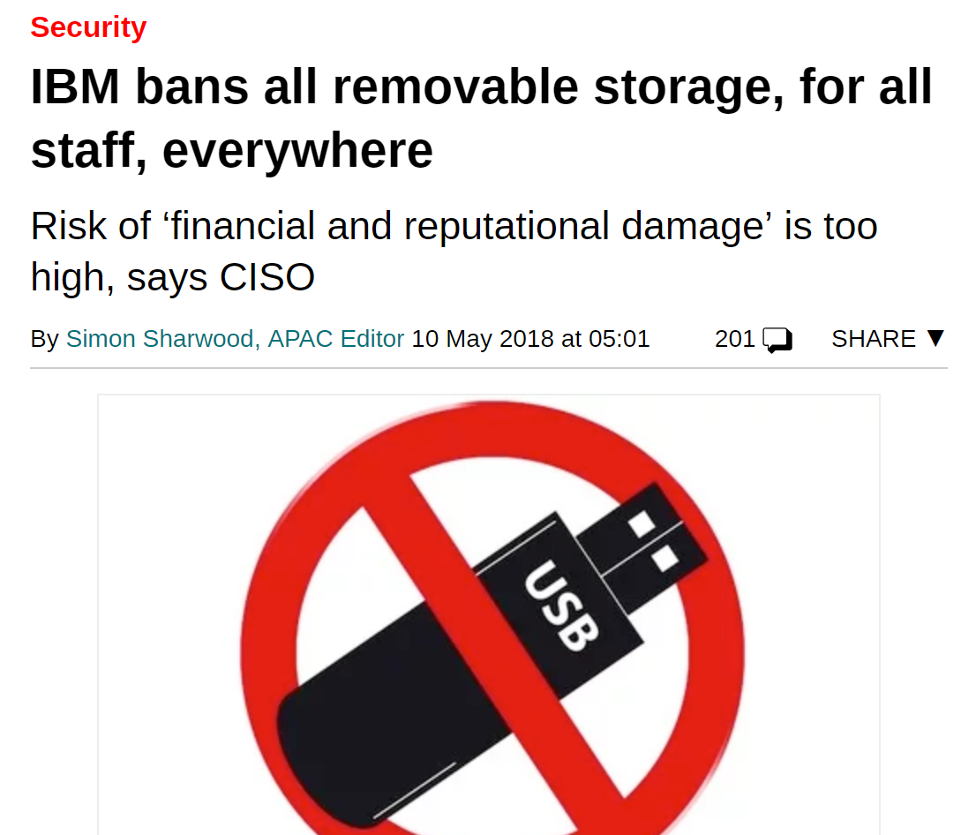
Big Blue’s doing this because “the possible financial and reputational damage from misplaced, lost or misused removable portable storage devices must be minimised.”
Notes:
Talk about major risks to school data - USB sticks being a biggie
If it’s good enough for IBM….
Discuss risks...encrypted devices still get lost...choose a better place to store data

Slide 18
Data Breaches
Confidentiality
Integrity
Availability
Serious breaches must be reported to the ICO within 72 hours
Report all breaches to your DPO, they can help decide if it needs reporting to the ICO
Notes:
CIA is an acronym often used to describe data breaches in ISO 27001
Discuss what constitutes loss of confidentiality (no encryption)
integrity - is the data up to date
Available...USB drive is encrypted but the data has been lost (applies to non-personal data too)

Slide 19
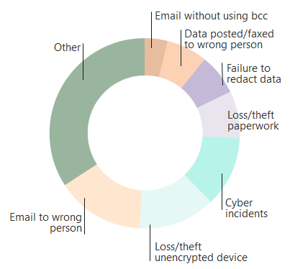
Reported Data Breaches
182 incidents reported to the Information Commissioner’s Office in 12 month period (Apr’16 - Mar’17)
** Other includes: insecure disposal; data left in insecure locations and any other ‘unclassified’ security breach.
4%
7%
7%
34%**
8%
12%
15%
13%
Notes:
Highlight the big risks:
Email
Unencrypted devices

Slide 20
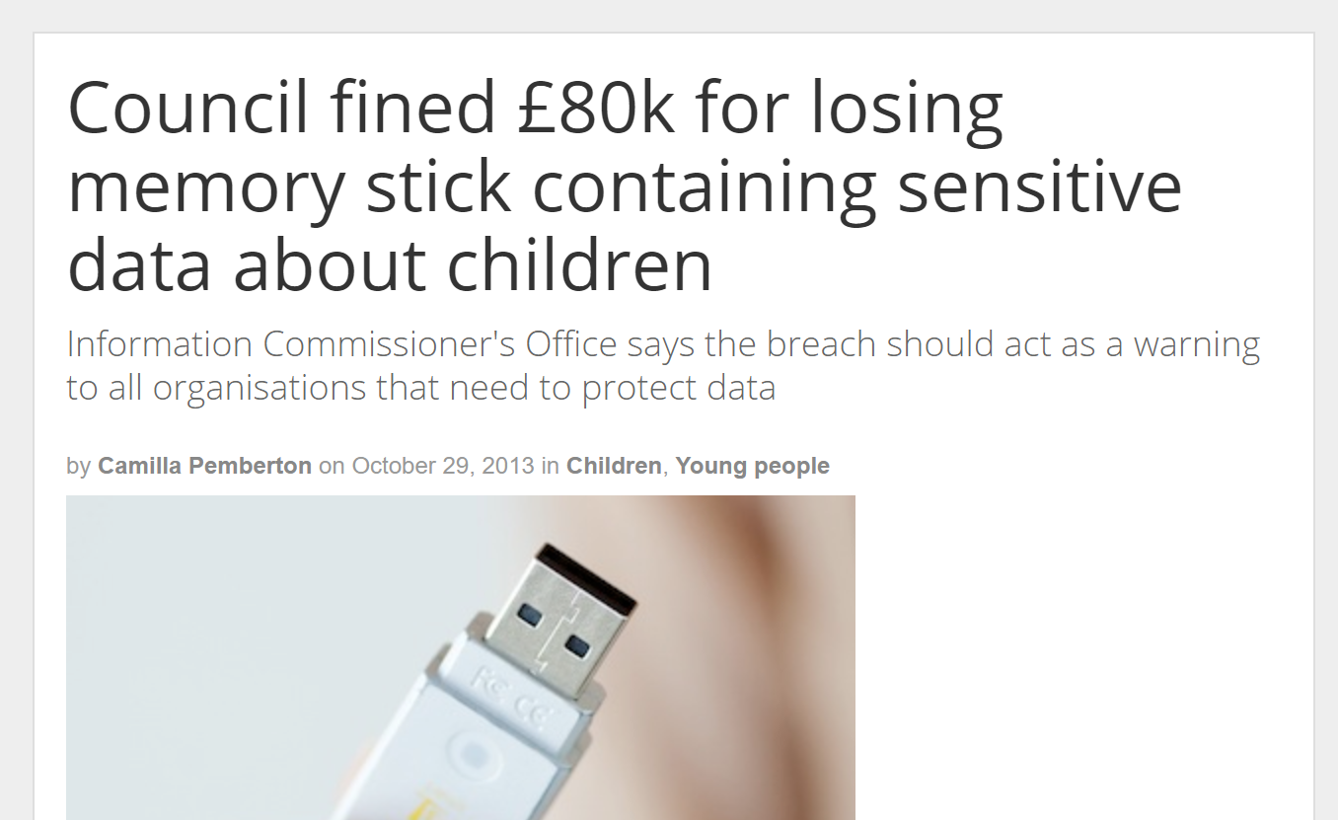
Breach Alert!
A council has been fined £80,000 for losing an unencrypted memory stick storing details of 286 children with special educational needs.
An internal report by North East Lincolnshire council found the children would suffer ill-health following the loss of the memory stick, which has been missing since July 2011. The stick contained personal details, such as mental and physical health problems, home addresses and teaching requirements.
It went missing after a special educational needs teacher left it stuck in a laptop and returned to find it gone. It has never been recovered.
Notes:
Need a reason not to use USB sticks????
Here are 80,000 of them

Slide 21
Protecting personal data
What would you do if you had a data breach?
Notes:
Discussion – what are the implications of a breach? (Data subjects’ rights + reputation of school + possible fines) – when and how do they need to be reported (to ICO + to data subjects) – How would you manage this process in your school? Do you have a procedure for this?
Key message – The actions taken to safeguard personal data indicates that an organisation takes rights of pupils and staff. Seriously. Majority of breaches are down to human error or lack of awareness – importance of training

Slide 22
Protecting personal data
What should be be looking out for?
(Data Protection by Design)
Notes:
We look for and find the same thing the ICO looks for...highlights from:
https://ico.org.uk/action-weve-taken/audits-advisory-visits-and-overview-reports/nurseries/

Slide 23

Sit down, I’ll do the washing up
Let me give you a lift to work in the morning
Notes:
Ask “what are these”?
Wait for the answer….tips? ….helpful tips!!

Slide 24
What the ICO looks for
Things done well:
Data protection policies
Physical security measures
Shredding
Consent for photographs
CCTV
Notice of fair processing
Notes:
Highlights from the ICO report

Slide 25
What the ICO looks for
Things that could be done better
Data protection training
Processes for reporting and investigating incidents
Process for dealing with subject access requests
Policies for sharing data with third-parties
Data retention schedules
USB sticks / laptops / device encryption
Email - content and cc’ing too many people

Slide 26
What the ICO looks for
Things that could be done better
Not enough use of encrypted email where appropriate
Weak passwords / not changed regularly
Antivirus / firewalls / malware
Secure printing
Secure disposal
Offsite data & bring-your-own device
Secure paper storage

Slide 27
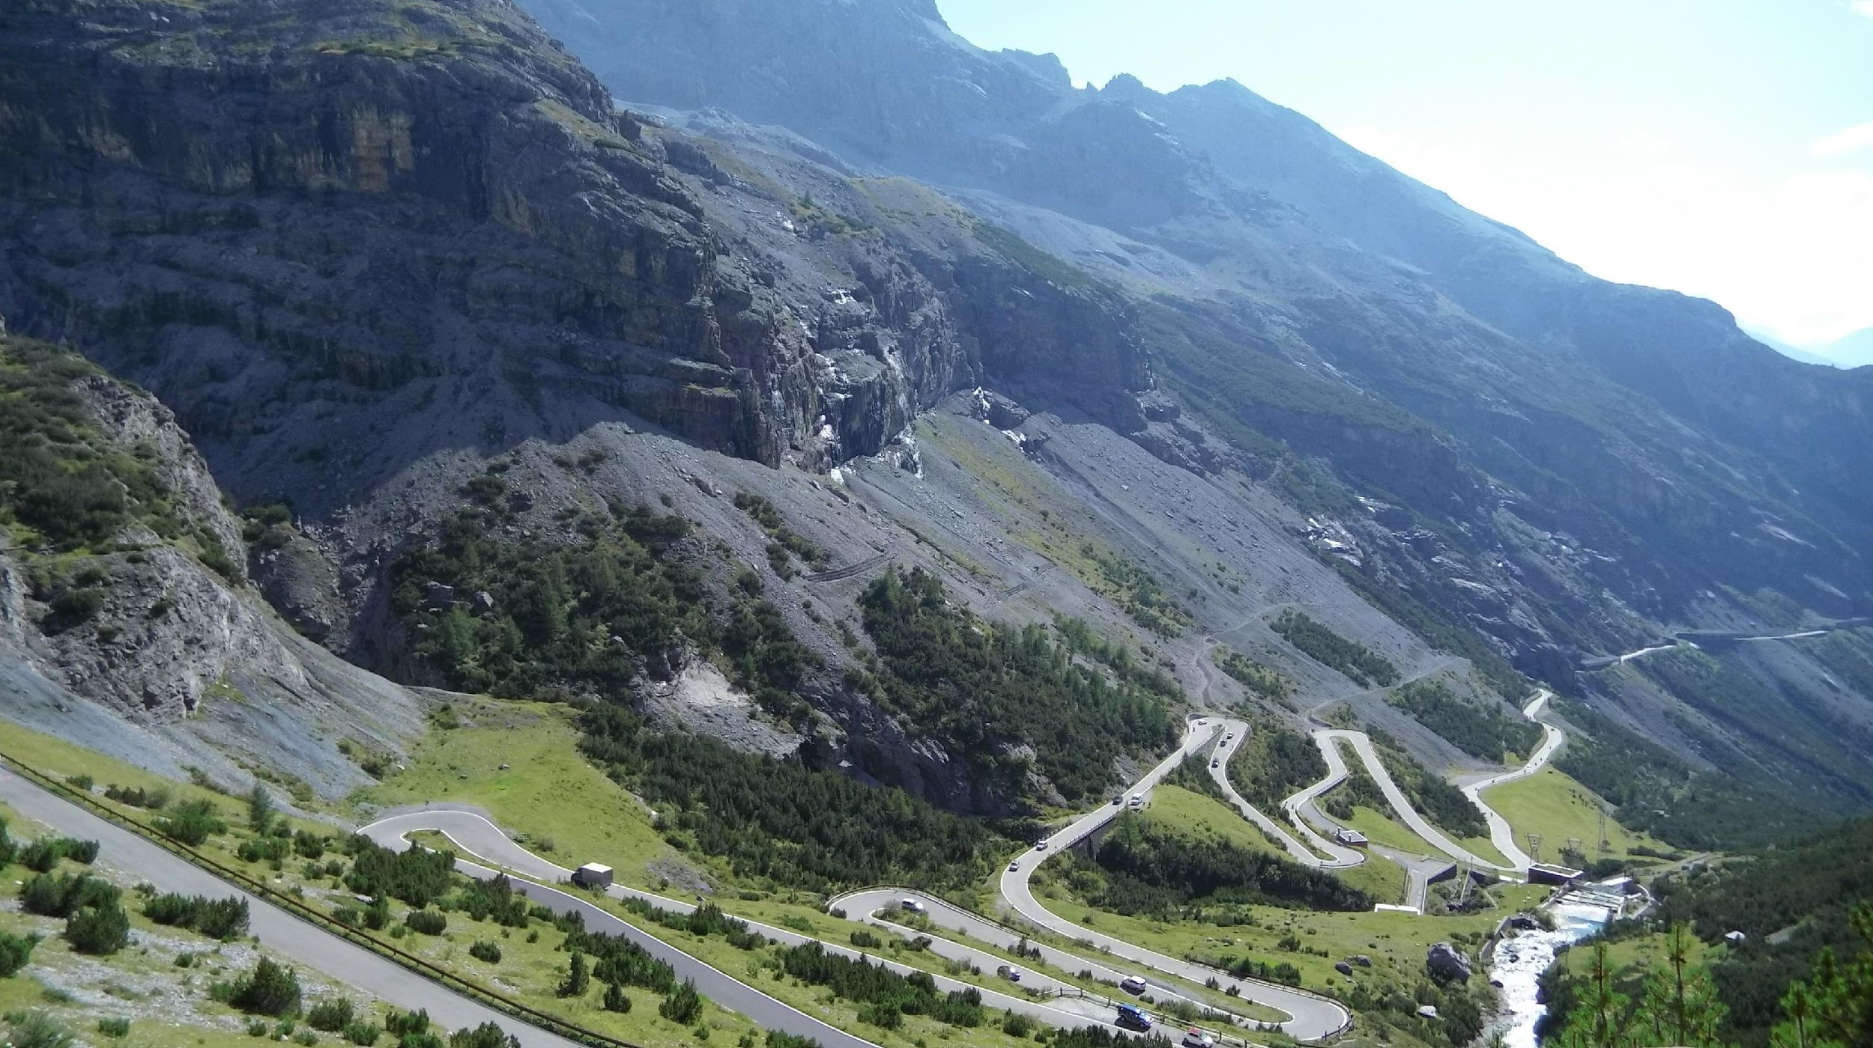
Notes:
GDPR is a long journey….

Slide 28

Notes:
But it is not a holiday.

Slide 29
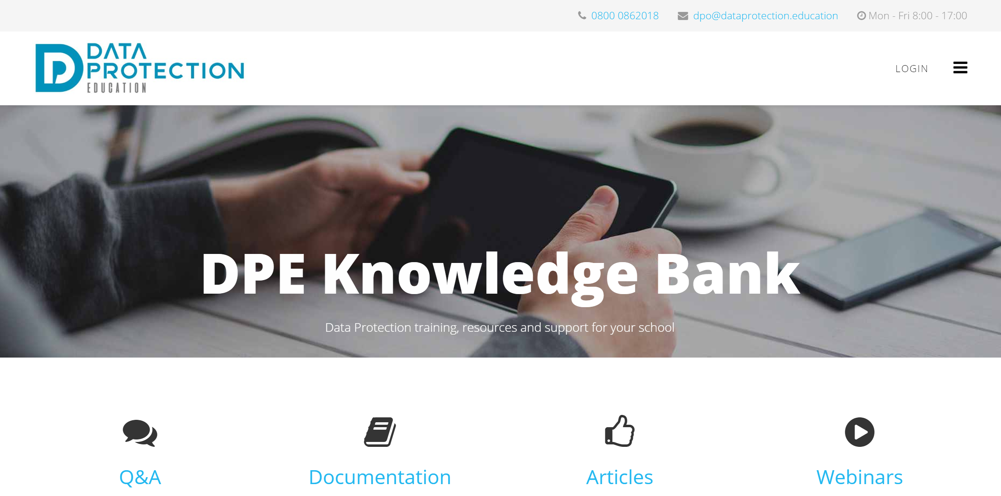
Notes:
Use the DPE Knowledge Bank for questions, documentation and further learning

Slide 30
Questions?
info@dataprotection.education
Tel: 0800 0862018
Notes:
Questions? If not now, get in touch.

